Slide 1
Calculus and Analytical Geometry

Slide 2

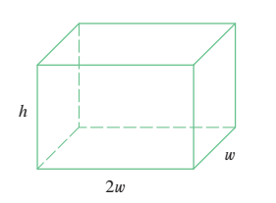

Slide 3



Slide 4
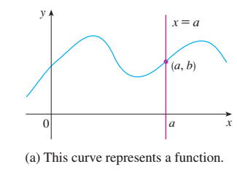
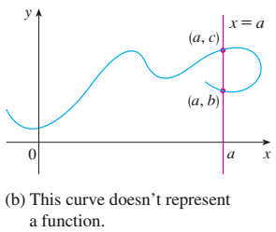

Slide 5



Slide 6
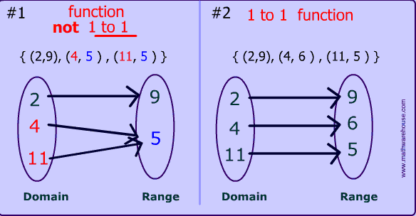
Types of function
One-one function: A function is said to be one-one if distinct element of X have distinct
images in Y . i.e if $x_{1}$ and $x_{2}$ are distinct element of X then $f(x_{1})≠f(x_{2})$ in Y.
For example, the function f(x) = x^2 is not a one-to-one function because it produces 4 as the answer when you input both x=2 and x= -2, but the function f(x) = x - 3 is a one-to-one function because it produces a different answer for every input.

Slide 7
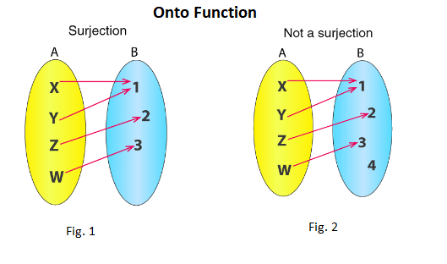

Onto function: A function is said to be onto function if each element of B is the image
of some element in A, i.e the range of function is the whole set B. $f(x_{1})=$
$f(x_{2})$ then if $x_{1}$ $=x_{2}$

Slide 8
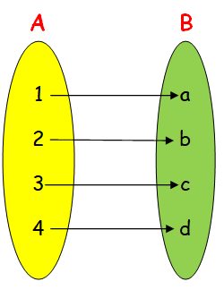
Bijective function: A function is said to be bijective iff it is both one-one and onto function.

Slide 9


Kinds of function

Slide 10



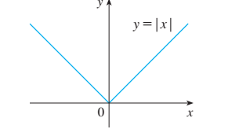

Slide 11
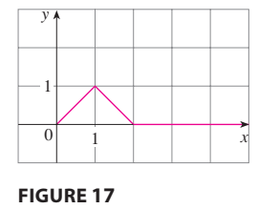
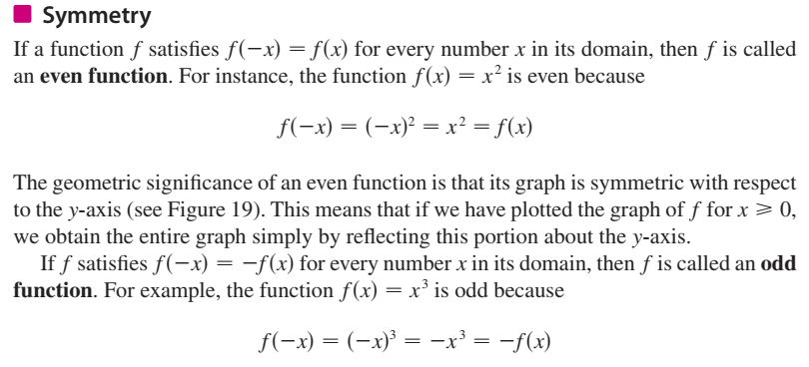
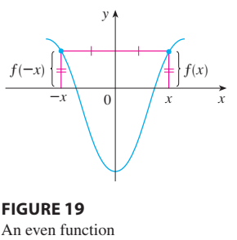

Slide 12

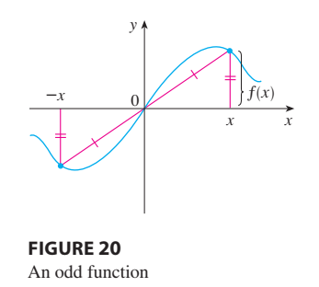


Slide 13


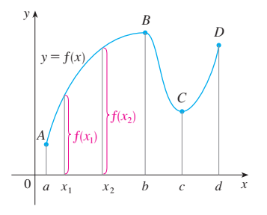
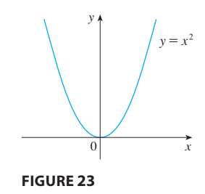

Slide 14
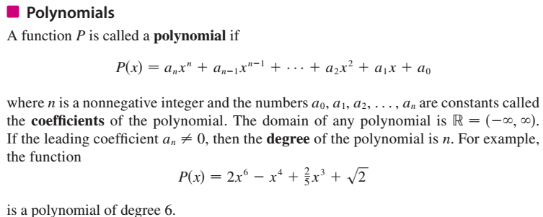

Slide 15


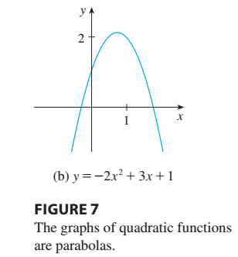

Slide 16


Slide 17




Slide 18

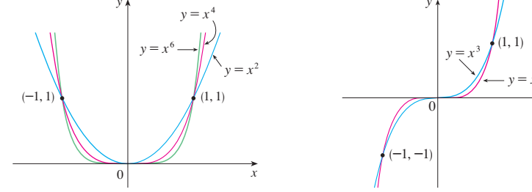
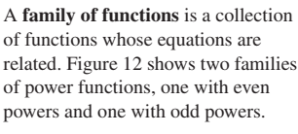


Slide 19


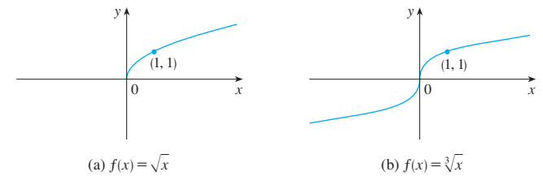


Slide 20
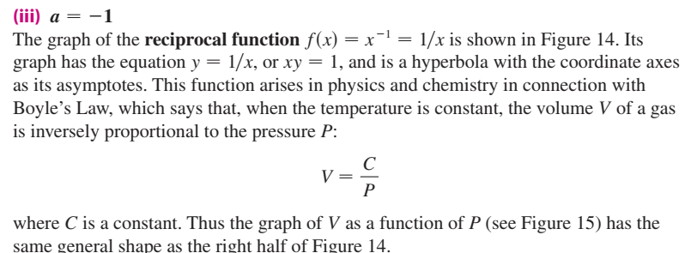
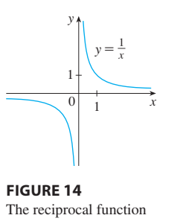

Slide 21
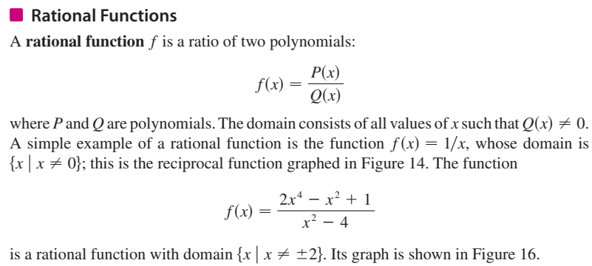
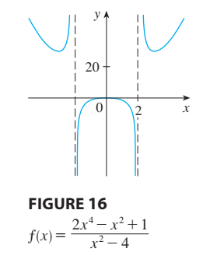


Slide 22



Trigonometric functions are elementary functions, the argument of which is an angle.
Trigonometric functions describe the relation between the sides and angles of a right triangle.
Applications of trigonometric functions are extremely diverse.
For example, any periodic processes can be represented as a sum of trigonometric functions (Fourier series).
These functions often appear in the solution of differential equations and functional equations.

Slide 23
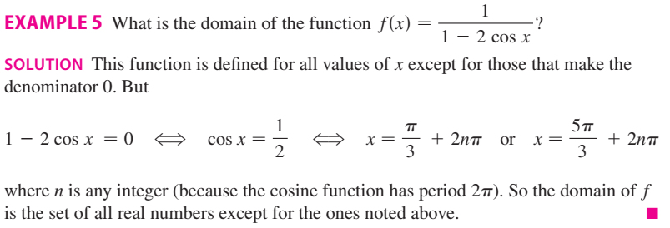

Slide 24

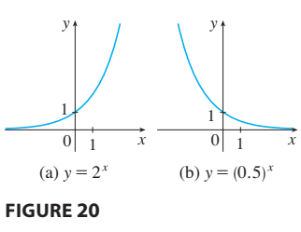

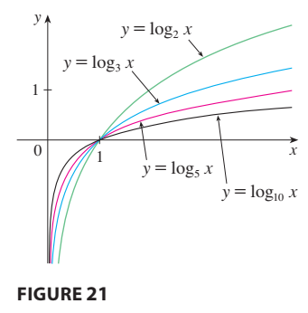

Slide 25



Slide 26


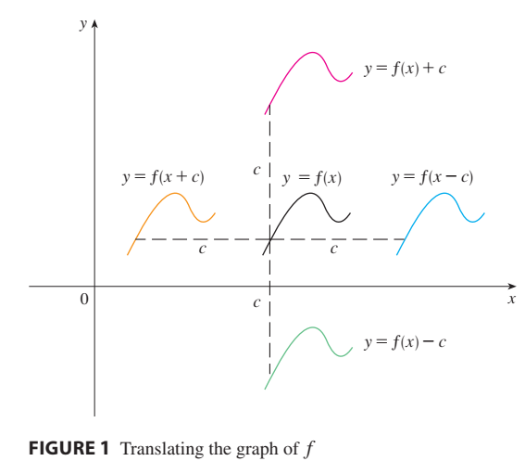


Slide 27
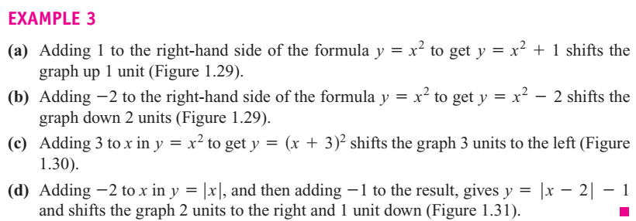
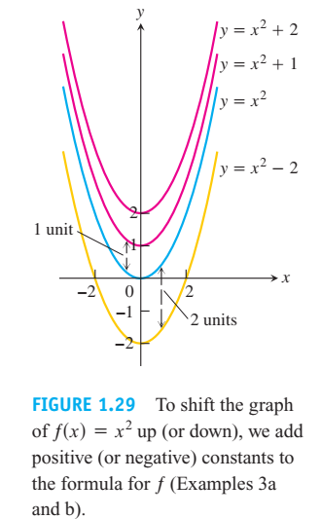
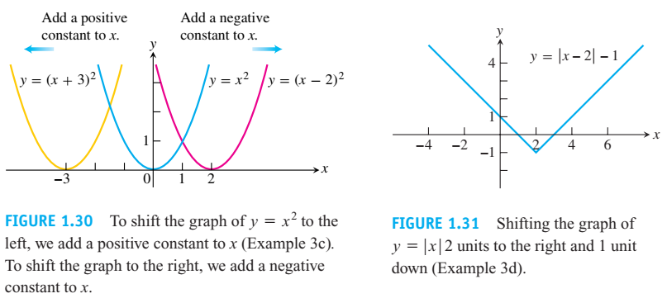

Slide 28
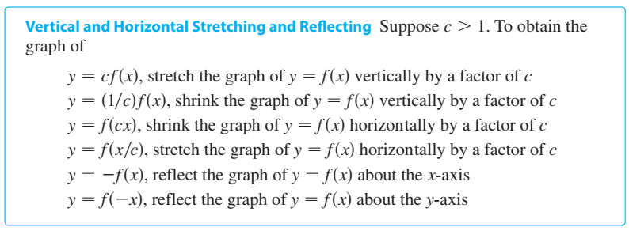


Slide 29
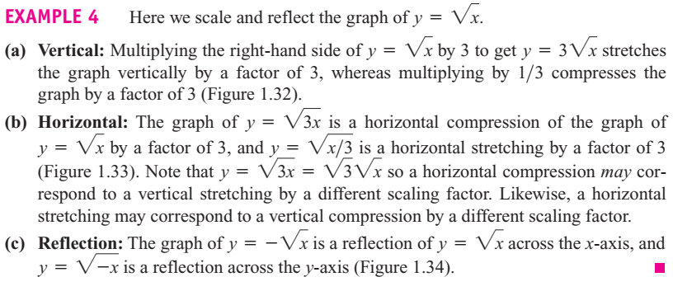


Slide 30

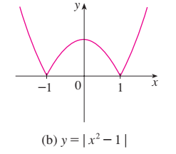

Slide 31

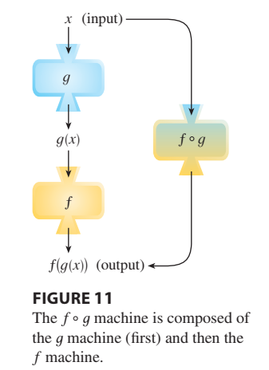



Slide 32




Slide 33




Slide 34
The End

